Slide 1
MENTAL HEALTH
CGU'S APPROACH TO MITIGATE THE RISING COST OF WORKERS COMPENSATION INSURANCE – REFLECTIONS & LEARNINGS
PRESENTED BY
MARC MCLENNAN
National Injury Management Team Lead, Workers Compensation Claims

Slide 2

CGU NAVIGATOR PROGRAM
Background
Program design
  CGU model
  System driven triage
Program implementation
Post-implementation
  Tracking benefits
  Embedding & continuous improvement

Slide 3
THE CHALLENGE – SECONDARY PSYCH
PRIMARY
PSYCHOLOGICAL INJURIES
SECONDARY
PSYCHOLOGICAL INJURIES
5% OF CLAIMS
Challenges accessing appropriate care impacts injured worker recovery, return to work, and claims costs
20% OF PHYSICAL INJURY CLAIMS
Difficult for insurers to identify early and address
4 x increase in costs on claims where secondary psychological impact is identified
_{PARTNERING WITH EXPERTS}
NAVIGATOR PROGRAM

Slide 4
CONSIDERATIONS
Customer
CGU manages claims in four schemes (ACT/NT/TAS/WA), supporting customers across vast geographies
Delivering a consistent customer experience
Low trust environment
The case manager
High demands, low control job
Typically not BPS experts
BPS care often secondary priority to claims processing matters

Slide 5
Number of early intervention service referrals
Making the process easy leads to higher utilisation

Slide 6
Timeframe to early intervention service referral
Making the process easy leads to faster service

Slide 7
DESIGNING A SOLUTION
Centre the person on the claim₁
Effective decision making supported by analytics & automation₁
Make it EASY, ATTRACTIVE, SOCIAL, and TIMELY₂
Taking Action: A best practice framework for the management of psychological claims in Australian workers’ compensation sector. Safe Work Australia.
Hallsworth, M. et al (2016). Applying Behavioral Insights: Simple Ways to Improve Health Outcomes. Doha, Qatar. World Innovation Summit for Health.

Slide 8
CGU MODEL – EFFICIENT & UNCOMPLICATED
CGU automated claim triage identifies new physical injury claims for service
Suitable claims automatically referred to Navigator Group within 1 week of lodgement
Navigator Group engages injured person.
Confidential & opt-in model builds trust and empowers injured person in their care
Navigator Group expert counsellors and psychologists provide individualised support for individuals at risk of mental health impact

Slide 9
SYSTEM DRIVEN TRIAGE
Philosophy of exclusion:
No privacy consent
Declined claims
Primary mental health claims
Fatality claims
NIHL & industrial disease claims
Medical expense only claims / fit PIDs
Catastrophic injury claims
MSK injuries identified by injury coding on lodgement

Slide 10
PROGRAM IMPLEMENTATION
Leader endorsement
Dedicated project manager
Stakeholder communication – internal and external
Claims consultant education – workshops
Formalise internal processes
Supporting documentation (e.g. information sheets)

Slide 11

A POSITIVE EXPERIENCE AT LOW COST
July 2021 to February 2023
+58
Injured workers supported
NPS
-100
0
30
70
+100
NT - 127
NEEDS IMPROVEMENT
GREAT
GOOD
EXCELLENT
WA - 388
Injured worker onboard rate | 55%
Average cost per onboarded claim | $1119.00 (inc GST)
ACT - 94
TAS - 234

Slide 12
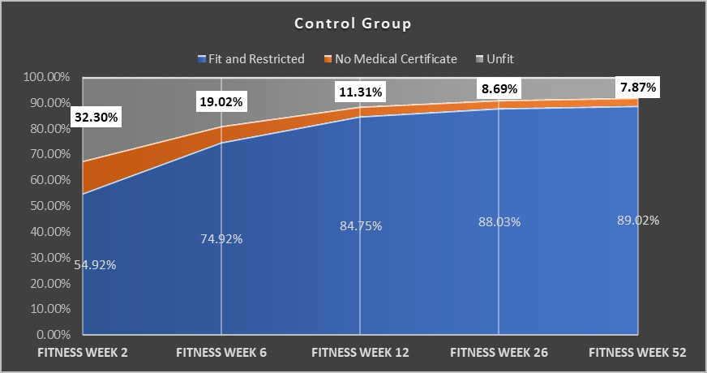
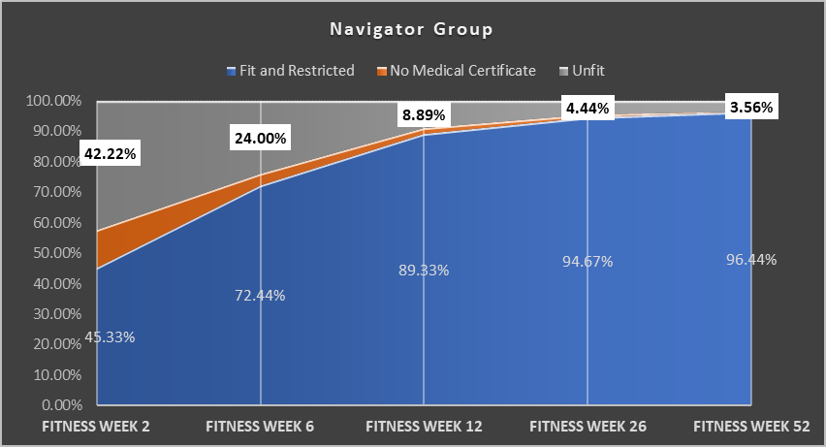
NAVIGATOR PARTICIPANTS RTW FASTER

Slide 13
EMBEDDING & CONTINUOUS IMPROVEMENT
Consider:
Onboarding new starters and refresher training for existing staff
Complaint escalation process
Feedback mechanism
Socialise positive stories

